Slide 1
Elementos de un problema de DistrictIn

Slide 2
Elementos del Problema
Función Objetivo
Variables de Decisión.
Restricciones
Parámetros

Slide 3
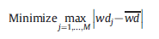
Función Objetivo
Función objetivo: Es aquella función que se optimiza, ya sea maximizando o minimizando su resultado
Ejemplo:

Slide 4
Variables de decisión
Las variables de decisión, son en teoría, factores controlables del sistema que se está modelando, y como tal, estas pueden tomar diversos valores posibles, de los cuales se precisa conocer su valor óptimo, que contribuya con la consecución del objetivo de la función general del problema.
Una variable de decisión es un elemento desconocido de un problema de optimización. Tiene un dominio, que es una representación compacta del conjunto de todos los valores posibles de la variable.
xij: Assignment decision variables. xij=1 if the basic unit i (i=1… N) is assigned to district j (j=1…M) and 0 otherwise.
• wdj: Total care workload of district j (j=1…M).
• gap_max: The maximum deviation (expressed as a percentage) between the care workload associated to each district and the average care workload among all districts.
• distance: The maximum distance that separates two basic units that are in the same district, among all the districts.

Slide 5
Restricciones
Restricciones: Son aquellas condiciones que deben cumplirse al optimizar la función objetivo. Puede tratarse de ecuaciones o inecuaciones algebraicas.
Parámetros
Los parámetros representan los valores conocidos del sistema o que se pueden controlar.

Slide 6
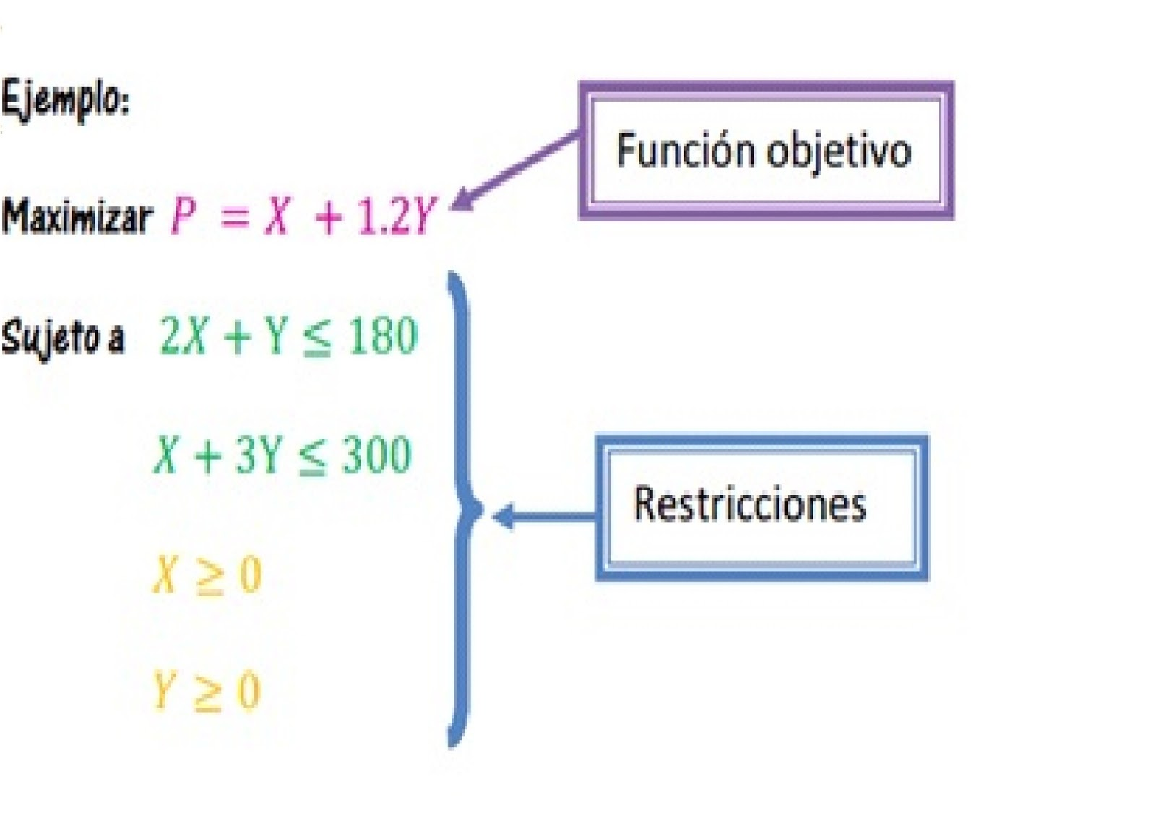
Ejemplo:
Parámetros

Slide 7
Parámetros
N: number of basic units.
• M: number of districts to design.
• H: number of patients' profiles considered.
• bh: Number of visits required by a patient of profile h (h=1…H) during his/her stay within the HHC system.
• Th: Average duration of a visit relative to the profile h (h=1…H).
• Pih: Number of patients living in the basic unit i (i=1…N) and having the profile h (h=1…H).
• dik: Distance between the basic units i (i=1…N) and k (k=1…N).
• dmax: Maximum distance allowed between two basic units that can be assigned to the same district.
• D: Set of basic units' pairs (i, k) where (i,k)∈D if and only if dik>dmax (used in Model 1).

Slide 8
Parámetros (Continuación)
• wd : Average care workload among all districts.
• τ: Admissible percentage deviation of the workload associated to a given district in comparison with the average workload among all districts (used in Model 2).
• eik: Compatibility index. eik=1 if the basic units i and k are compatible, and 0 otherwise. The basic units i and k can be incompatible for several reasons: a) existence of geographical obstacles between them, b) difficulty or impossibility to travel from one basic unit to another by the means of transportation used by the caregivers (public transportation, private cars, etc.) or c) they do not belong to the same administrative district.
• E: Set of basic units' pairs (i, k) where (i,k)∈E if and only if eik=0.

Slide 9
Criterios para las restricciones
Compactness can be integrated into the models in two ways. First, the compactness can be formulated as a hard constraint by limiting the maximum distance between two basic units that would be assigned to the same district (i.e. Model 1). The second formulation consists of minimizing a compactness measure which is the maximum distance between two basic units assigned to the same district.
The accessibility is also crucial in the HHC context since it is related to the easiness by which the caregivers can travel within a district, for example by means of public transportation, private cars, etc. The accessibility can also be assessed by the respect of geographical obstacles such as mountains, bodies of water, etc.
The indivisibility of basic units where each basic unit must be assigned to one and only one district. This criterion is considered in order to avoid interference between caregivers' responsibilities and to establish long-term relationships with patients.
The workload balance is essential for the design of “good” districts. It consists of having almost the same workload in the different districts. The analysis of the workload shows that it is essentially composed of the care workload and the travel time. Since the travel time is related to the distances between the different patients’ home whose reduction is guaranteed by the compactness criterion,
Distance = The value of the maximum distance between two basic units that can be assigned to the same district for each instance

Slide 10
Elementos de la Solución
Centroide de cada Distrito: Punto Representativo (central) de cada distrito.
Unidades básicas asignadas a cada distrito: Conjunto de Unidades básicas asignadas a cada distrito.

Slide 11
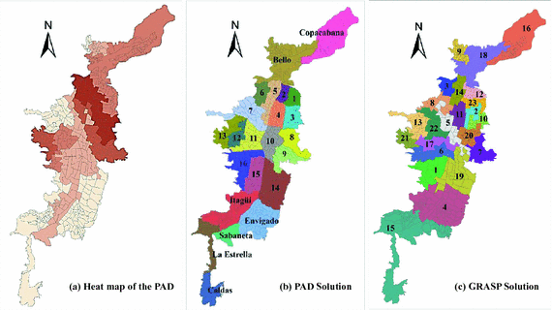
Districtin Solution

